Slide 1
Technical Onboarding Manager Training

Slide 2
Agenda
What is the Cloud Migration Center (CMC)?
Who is part of the CMC?
Where does the TOM role fit in the CMC?
Workload Migration Process
TOMs Training Outline

Slide 3
What is the Cloud Migration Center (CMC)?

Slide 4
What is the Cloud Migration Center?
The CMC Department handle all the workload migration to the client’s new Azure environment.
We work closely with the Delivery Director and/or Delivery Manager and client on which workload to migrate.
Schedule out migration on a week-to-week basis
Post support for 2 week after migration

Slide 5
Who is part of the Cloud Migration Center (CMC)

Slide 6
Who is part of the Cloud Migration Center?
The CMC Team is divided into PODs. Each PODs consist of the following CMC roles:
CMC Team Lead
CMC Engineer
Technical Onboarding Manager

Slide 7
Who is part of the Cloud Migration Center?
The CMC Team consist of the following Roles:
CMC Team lead Their role is to handle reviewing the SOW, the deliverables, and the execution plan of the project. They will also be assigning the Engineer for the project.
CMC Engineer Their role is to handle the execution of the migration to the Azure Environment. They will work hand in hand with the DM/DD, Project Architect and the TOMs which also includes post support for the client for 2 weeks after migration.
Technical Onboarding Managers (TOMs) Their role is to work closely with the client on gathering server information and making sure that the project is on track from the CMC side. Set up daily or weekly meetings with the internal team and/or the client to review application, update Status on the migration, and workloads. Keep ADO up to date and keep notes on status.

Slide 8
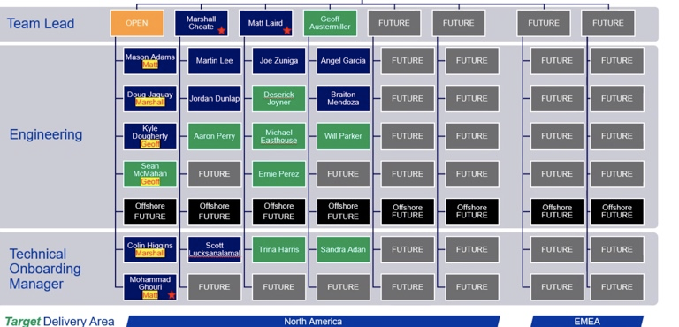
Who is part of the Cloud Migration Center?

Slide 9
Where does the TOM role fit?

Slide 10
Where does the TOM role fit?
The TOM role is being the liaison for the CMC Team and the Client.
We make sure we gathering server information using the Workload Discovery Sheet
Making sure that the project is on track from the CMC side.
Set up daily or weekly meetings with the internal team and/or the client review application, Go/No Go meetings, update Status on the migration, and workloads.
Keep ADO Board up to date by making sure the engineers are updating them and keep notes on status.

Slide 11
Understanding Workload Migration Process

Slide 12
Workload Migration Process
Landing Zone
Pilot
Discover
Migrate
Manage,
Optimize, Secure
Evaluate current landing zone, or prepare the landing zone
Provide recommendations on any findings
Remediate where needed
Migration Tooling Setup (ASR)
Migrate pilot server group or workload
Learn your environment
Establish build processes
Fine-tune processes
Begin Discovery
Prioritize migration workloads and align to phases
Workload analysis and architecture deep dive
Assess workload for cloud readiness
Identify migration strategy for each workload
Adjust initial migration plan, if needed
Schedule migration with the CMC
Replicate the workloads to the target Azure regions
Perform failover testing
Cutover the workloads to the target Azure regions
Perform post-failover setup for the workload and handoff to 10th Magnitude’s Managed Services
Managed operations
Optimize migrated workloads
Secure migrated workloads
MBG Managed Services
This portion is handled by the Tech Lead / Project Architect and Delivery Manager
Technical Onboarding Manager
CMC Engineer Team

Slide 13
Sample Migration Cycle
Continuous Discovery and Migration
Week 1
Week 2
Week 3
Week 4
Week 5+
Discovery
Meet with workload owners and stakeholders to gather information, dependencies, timeline and build a plan for migrating the workload or workload group.
Migration Group 1 - Pilot
Identify a low impact workload for tooling and process testing
Conduct a migration to demonstrate and fine tune tooling, process, plans
Start discovery for the next migration group
Migration Groups 2+
The 10M Migration Center will replicate and perform cutover on groups of workloads
Perform testing to verify the workload meets customer standards
Transition
Transition the workload to 10M Managed Services
Provide documentation
Repeat
Cycle through the process to quickly migrate groups of servers and workloads
Migration Leadership Team Sprint - 2 Weeks
Ongoing Work
Migration Leadership Team
Landing Zone Assessment and Preparation
Group 1 - Pilot Discovery
Group 2 Discovery
Group 3 Discovery
Group n
Discovery
Group 1 - Pilot Migration
Group 2 Migration
Group n
Migration
Migration Center
Sprint - 1 Week
Cloud Migration Center
Managed Services

Slide 14
Understanding Client’s Environment

Slide 15
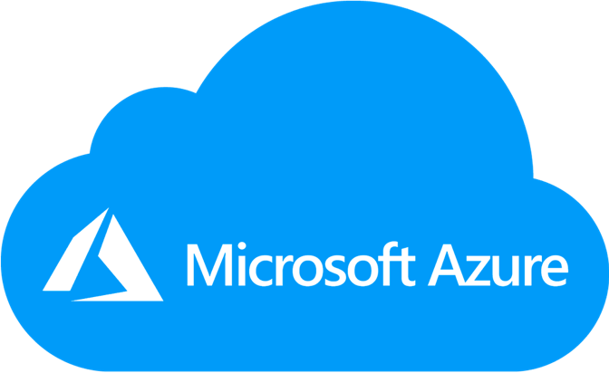

Client’s Environment ( High Level) Example *This is an example scenario. Not all client have the same environment
Azure Cloud
Client’s On Prem Server or Datacenter
Network/Virtual Network/Firewall
Network/Virtual Network/Firewall
Migrate
Server
Server
Server
Server
Server
Server
Server
Server
DB
DB
DB
DB
DB
DB
DB
DB
Apps
Apps
Apps
Apps
Apps
Apps
Apps
Apps
Apps
Apps
Apps
Apps
Apps
Apps
Apps
Apps
Apps
Apps
Apps
Apps
Apps
Apps
Apps
Apps
Migrate
Apps
Apps
Apps
Apps
Apps
Apps
Apps
Apps
Apps
Apps
Apps
Apps
Apps
Apps
Apps
Apps
Apps
Apps
Apps
Apps
Apps
Apps
Apps
Apps
Apps
Apps
Apps
Apps
Apps
Apps
Apps
Apps
Apps
Apps
Apps
Apps
Apps
Apps
Apps
Apps
External Users accessing the app (client’s customers)
Benefits of the Azure Cloud
Client’s Customer
Client’s Customer
Client’s Customer
Client’s Customer
Client’s Customer
Client’s Customer
High Availability
Scalability and Elasticity
Low Latency
Reduce CapEx
Client’s Customer
Client’s Customer
Client’s Customer
Client’s Customer
Client’s Customer
Client’s Customer
Client’s Customer
Client’s Customer
Client’s Customer
Client’s Customer
Client’s Customer
Client’s Customer
Client’s Customer
Client’s Customer
Client’s Customer
Client’s Customer
Client’s Customer
Client’s Customer

Slide 16
What is a Landing Zone?

Slide 17
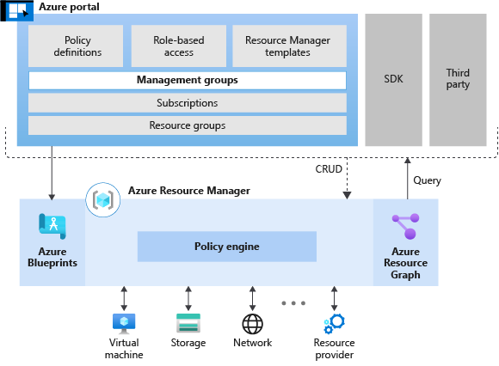
What is a Landing Zone?
Azure landing zones are the output of a multi-subscription Azure environment that accounts for scale, security, governance, networking, and identity. The Azure Landing Zone is basically, in it's simplest form a bunch of services within Azure that give you a place to somewhere to deploy other Azure services. It is the foundation of the client Azure cloud Environment.

Slide 18
Who Are Managed Services?

Slide 19
Who Are Managed Services
The Manage Services Team offers the following services below:
App, Infrastructure, & Network Monitoring
Incident & Problem Management
DevOps Automation
Cost & Perf Optimization
Modern Service Management & ITIL
Patch Management
Backup Management
Unified Security Management
Disaster Recovery
Provisioning Management
24x7 Technical Support
Subscription Management
Azure Cost Management
Governance Management
Customer Portal
Cloud Management Platform
*Not all project comes with this services.

Slide 20



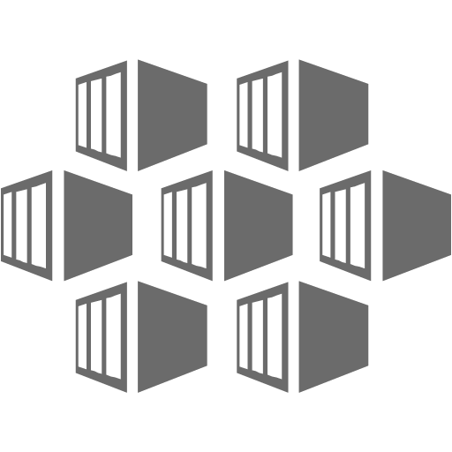

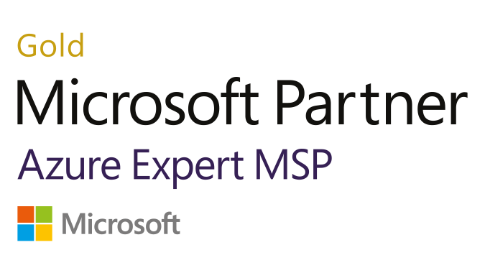



Azure Managed Service
Subject Matter Experts
Business Application Development and Operations
Business Application Management
Cloud EngineeringStandards
Your Teams
10M Architecture, Engineering, and Build
Professional Services
App, Infrastructure, & Network Monitoring
Incident & Problem Management
DevOps Automation
Cost & Perf Optimization
Modern Service Management & ITIL
Patch Management
Backup Management
Unified Security Management
Disaster Recovery
Provisioning Management
24x7 Technical Support
Subscription Management
Azure Cost Management
Governance Management
Managed Services
Customer Portal
Cloud Management Platform
Infrastructure & Services
Microsoft
Azure
IaaS
PaaS
Containers
Data
Network
Storage

Slide 21
Questions and Answers

